Slide 1

WHAT IS DAILY NEWS?

Slide 2

HOW IT WORKS

Slide 3
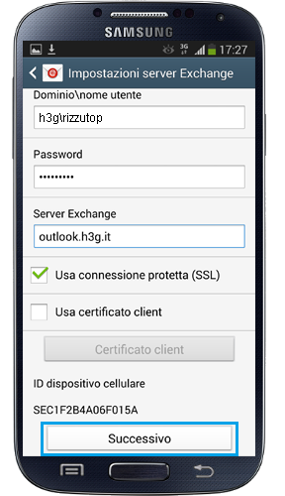
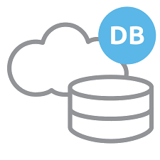
INTERACTION WITH SERVER

Slide 4
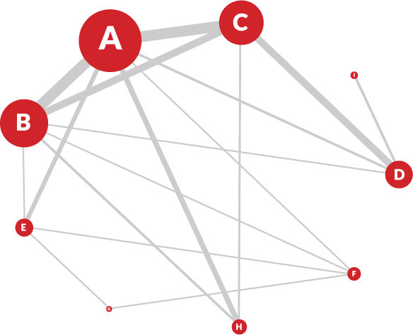
BAYESIAN NETWORK META-ANALYSIS

Slide 5
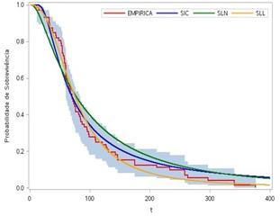
NOW vs FUTURE

Slide 6
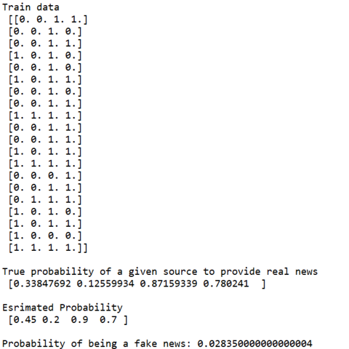
SAMPLE OUTPUT OF BAYESIAN NETWORK

Slide 7
QUICK REVIEW OF OUR APP

Slide 8
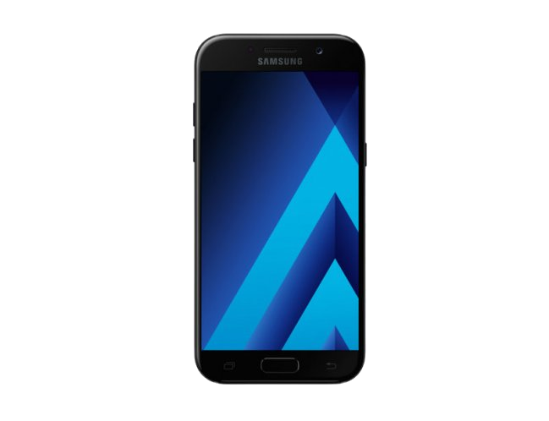
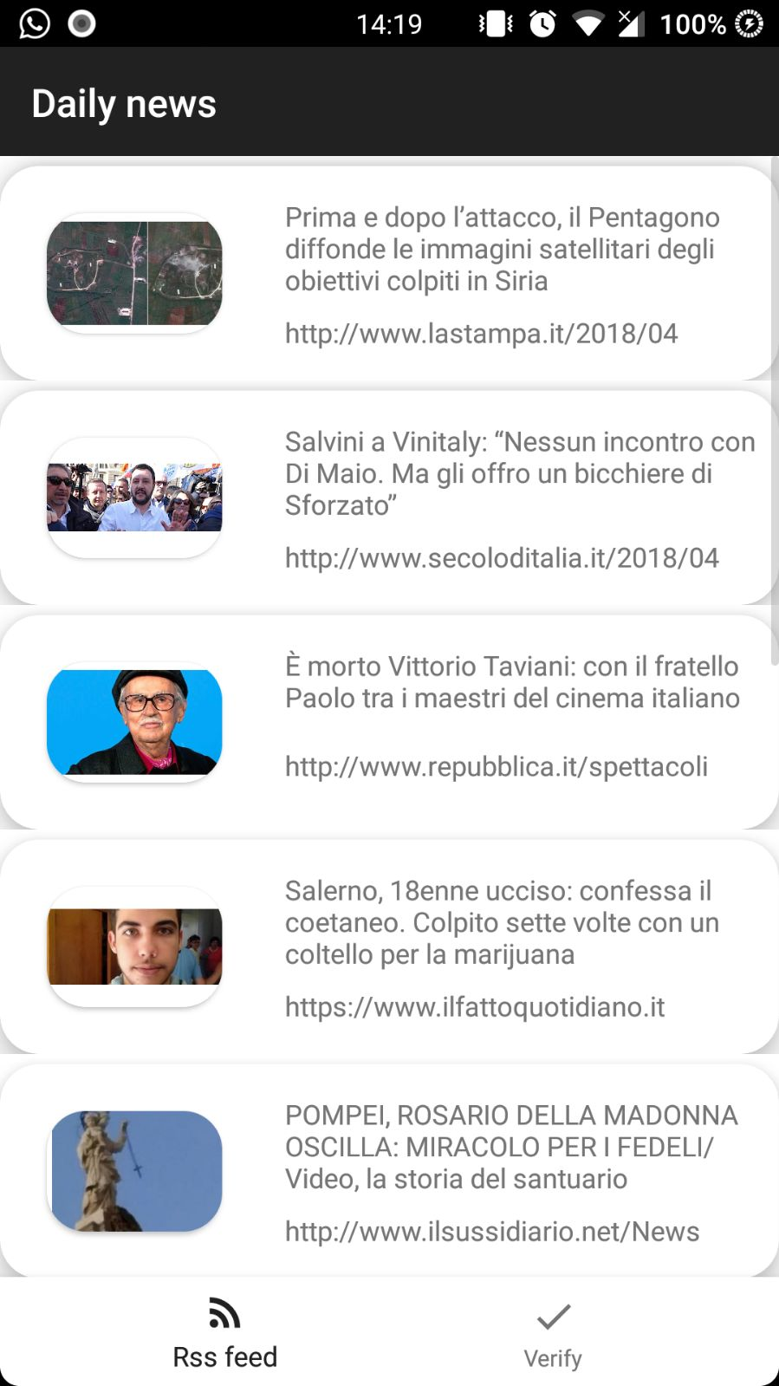
LAYOUT

Slide 9
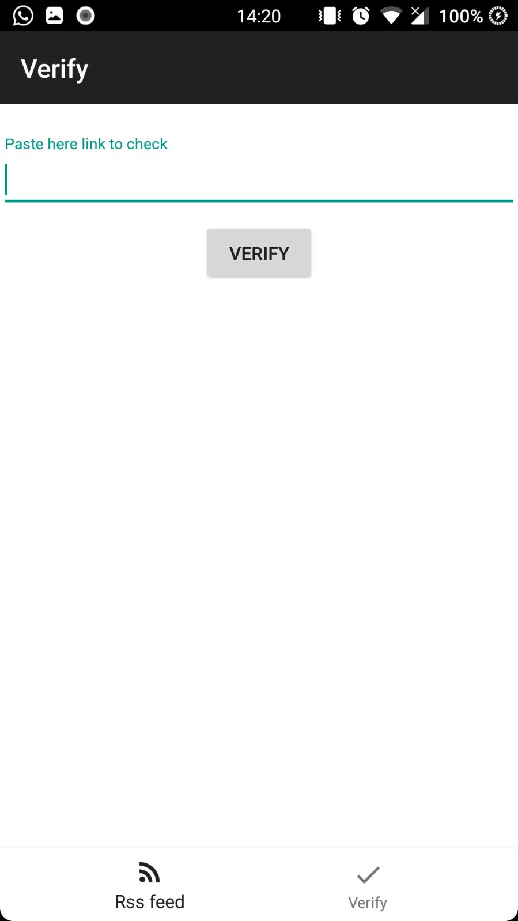
FAKE NEWS DETECTION

Slide 10
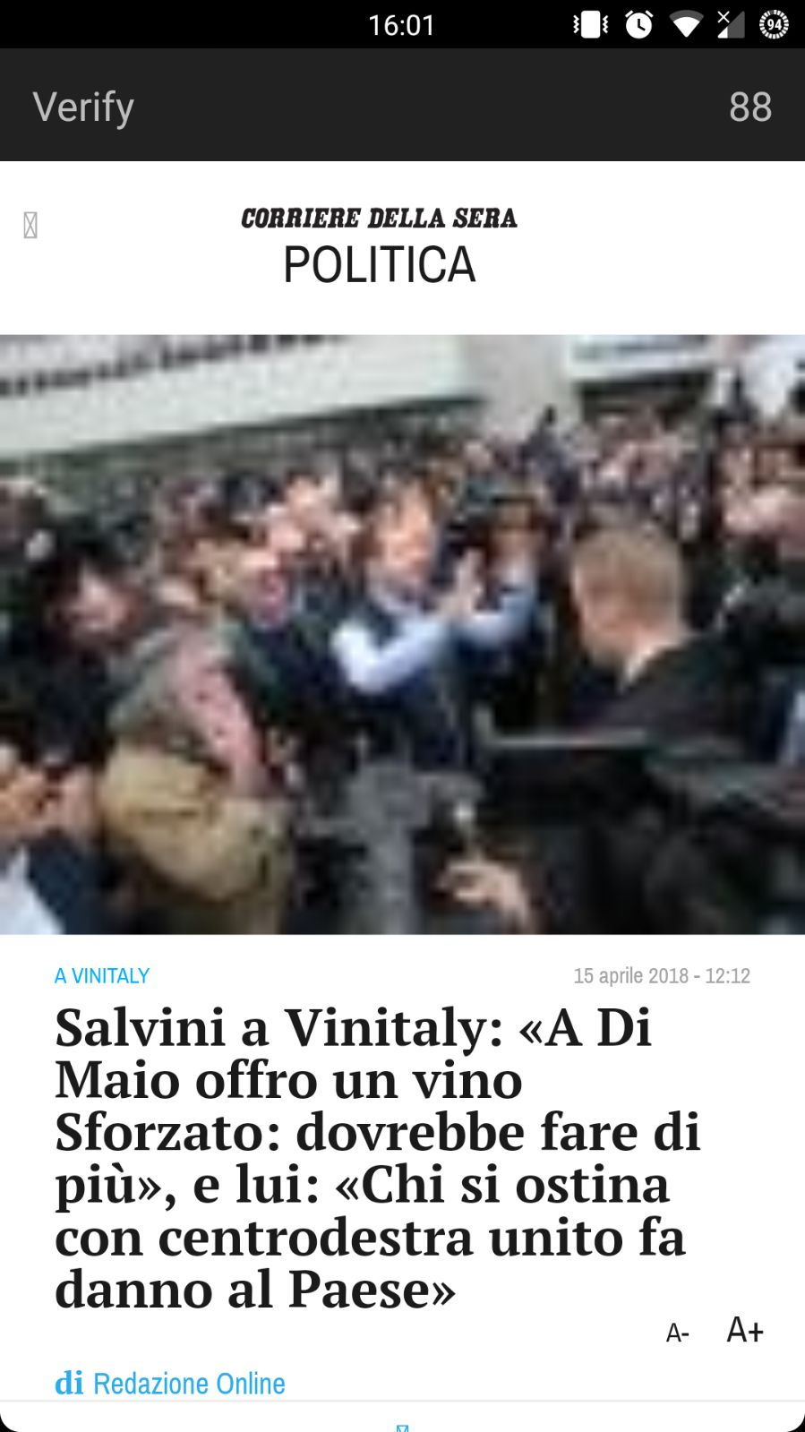
SOURCE RELIABILITY

Slide 11
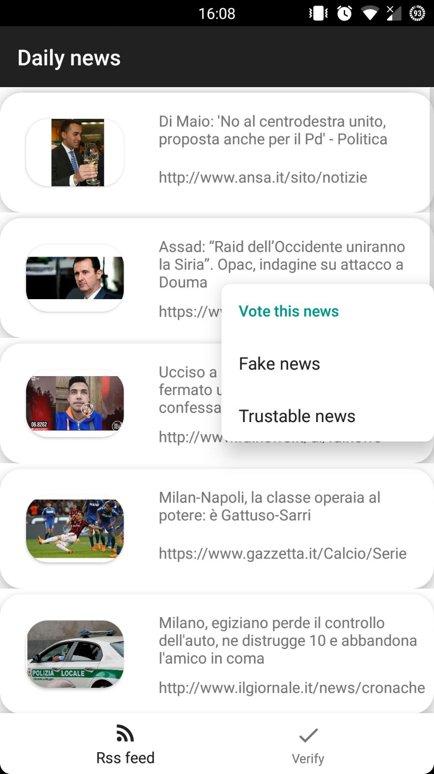
USERS FEEDBACK SYSTEM

Slide 12
DEVELOPED BY:
COMBETTO PAOLO
GATTIGLIO GUGLIELMO
MASOERO SIMONE
PLANO NICOLAS
SCHEMBRI FRANCESCO

